Slide 1

Building the Lean Stack Canvas
Sheryl Satorre-Estella, PhD.

Slide 2
Outline
What is Lean Stack Canvas?
Lean Stack Canvas vs Business Model Canvas
Lean Stack Canvas Components

Slide 3
Lean Stack Canvas
Lean Stack Canvas is an adaptation of Business Model Canvas by Alexander Osterwalder which Ash Maurya created in the Lean Startup spirit (fast, concise and effective startup)
It focuses on problems, solutions, key metrics and competitive advantages.

Slide 4
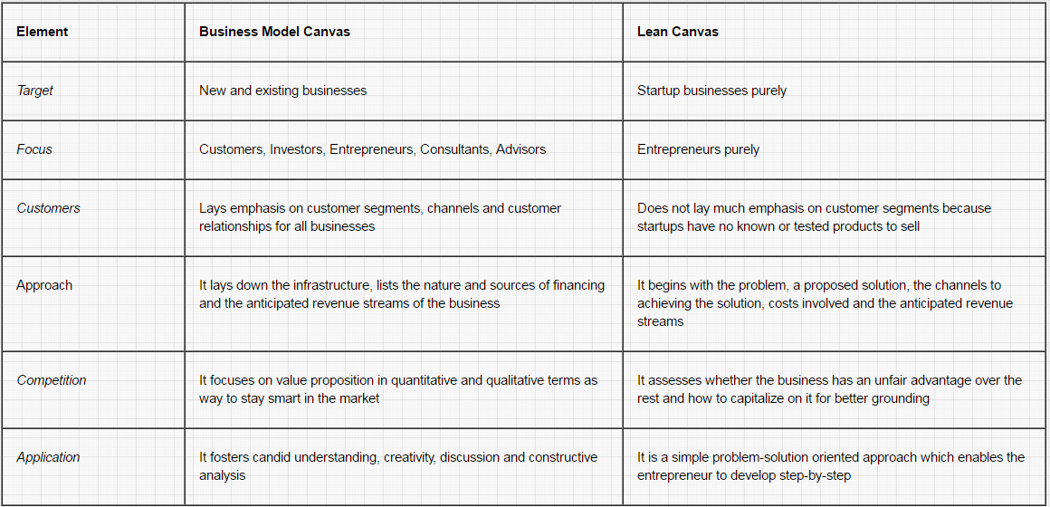
Lean Stack Canvas vs. Business Model Canvas

Slide 5
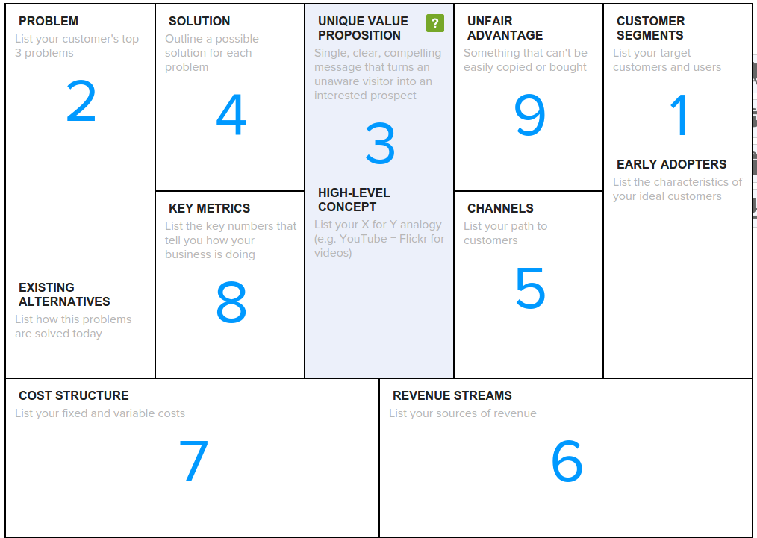

Slide 6
Photo and Video Sharing Service
Notes:
We shall use the startup idea about a Photo and Video Sharing service as a sample scenario for the entire lesson.

Slide 7
1
Customer Segments
List your target customers and users.
Customer is someone who pays for your product.
User is someone that interacts with the product or service of the customer.
Early Adopters
List the characteristics of your ideal customers.
Early Adopter is a customer that you have defined with specific attributes and will initially target.
Notes:
Think of your early adopters as hitting an easy button.
The logic behind early adopters is that if you can’t get them to need and want your product, it would be harder to get anyone else.

Slide 8
Customer Segments:
Really broad customer segment: anyone who’d like to share photos and videos online
WHY?

Slide 9
Customer Segments:
Really broad customer segment: anyone who’d like to share photos and videos online
List possible customer segments:
Photographers
Graphic Designers
Parents
Creatives
Notes:
Be specific with your customer segments. In the above example, it is possible that I can group Photographers and Graphic Designers as Creatives. Thus, I have two customer segments: Creatives and Parents. This would require me to create two separate lean stack canvases.

Slide 10
Example:
Customer Segments:
Parents (creators)
Family and friends (viewers)
Early Adopters:
Parents with young kids

Slide 11
2
Problem
List your customer’s top 3 problems/pain points
Use 5-WHYs Technique (root cause analysis)

Slide 12
5-WHYs
Customer Segment:
1st time Moms with kids under 3 years old
PROBLEM: photo and video sharing is hard
1. WHY
2. WHY
3. WHY
4. WHY
5. WHY
There are lots of baby photos.
Babies change fast and people want to see updates.
It’s time consuming.
There are lots of external demand from family.
Organizing and uploading of photos take time.
I want to share special moments with others.
Parents have no free time.
Sleep deprived

Slide 13
Example:
Problems
It is time consuming.
Parents have no free time.
There are lots of external demand from family.

Slide 14
2
Existing Alternatives
What solution(s) that your early adopters currently use to try to solve the listed problems?
Think beyond the category

Slide 15
Example:
Existing Alternatives
Facebook
Flickr
Email
Instagram

Slide 16
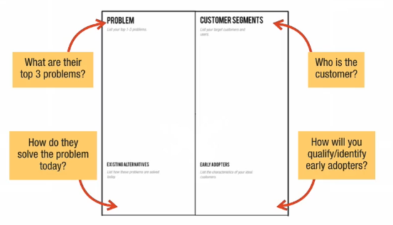
Fundamental Components of Lean Stack Canvas

Slide 17
3
Unique Value Proposition (UVP)
Craft a clear message that states your offer and why you are different.
Your unique value proposition is the promise you make to customers.
For new products, the initial battle is getting noticed at all.
Notes:
The goal of UVP is turn an unaware visitor into a potential prospect. This is what you use as the headline on your landing page. A good UVP gets inside the head of your customer and describes the value proposition from their world view.

Slide 18
3
Unique Value Proposition (UVP)
Craft your UVP around your top problem and finished story benefit.
Avoid empty buzz words.
Notes:
Finished story benefit refers to the value your customers derived after using your product. For example, in a Job Listing site, the finished story benefit is a promise to job seekers find their dream job.

Slide 19
3
Unique Value Proposition (UVP)
End Result Customer Wants + Specific Period of time + Address the Objections
Examples:
Hot fresh pizza delivered to your door in 30 minutes, or it's free.
Get your dream job in 30 days.
Reliable and relevant search results in less than a second.

Slide 20
Example
Unique Value Proposition (UVP)
Get back to the more important things in your life. Faster.
Share your entire photo and video library in less than 5 minutes.

Slide 21
3
High-Level Concept
Craft a high-concept pitch to help spread your message.
Example: YouTube - Flickr for Video

Slide 22
Example
High-Level Concept
Photo and video sharing without the uploading

Slide 23
4
Solution
Define the minimum feature set needed to solve your top 1-3 problems.
Outline a possible solution for each problem.
Don't spend too much time fleshing out your solution yet.
Notes:
For each of the problems outline earlier, sketch out the top features or capabilities that will address those problems. Don't get carried away with fully defining a solution just yet. Simply outline a possible solution for each problem.
These features will form the basis for your Minimum Viable Product (MVP).
MVP is the smallest feature set that lets you start learning about customers.
Don't confuse your MVP with a minimum product.Your MVP needs to address your top customer problems and deliver on your Unique Value Proposition.

Slide 24
Example:
Solutions
Instant no-upload sharing
iPhoto/folders integration
Better notification tools

Slide 25
5
Channels
Start building a significant path to customers from day one.
Identify how you will find your first 10 customers.
What inbound channels can you start building today?
Notes:
Channels are how you reach your customers. The more specific your early adopters definition, the easier to formulate specific channels for reaching them.

Slide 26
Example
Channels
Friends, Daycare, Birthday Parties, Word of Mouth
Facebook, Adwords
Website, Mobile App

Slide 27
6
Revenue Streams
Identify how you will make money.
Brainstorm different revenue models.
Examine the pricing of existing alternatives.
Pick a starting price to test.
Notes:
A business model without revenue is not much of a business. Getting paid is one of riskier parts of your model and something that needs to be tackled as early as possible.
Picking a price is more art than science. Not only does your pricing model keep you in business, it also signals your branding and positioning which determines your customers. A good starting point is using your customer's existing alternatives as pricing anchors.

Slide 28
Example:
Revenue Streams
30-day trial
Premium: $49/year

Slide 29
7
Cost Structure
List your fixed costs and variable costs.
List your immediate fixed costs.
List your immediate variable costs.
Calculate your break-even point.
Notes:
List the operational costs you will incur while taking your product to market. It's hard to accurately calculate these too far into the future. So instead, focus on the present. What will it cost you to interview 30-50 customers? What will it cost you to build and launch your MVP? What will your ongoing burn-rate look like?

Slide 30
Example
Cost Structure
Hosting costs
Research and Development
Marketing and Promotion

Slide 31
8
Key Metrics
Identify the key numbers that tell you how your business is doing in real time.
Identify your top 3-5 key metrics based on the stage of your product.
Map specific user actions will use to track these metrics.
Notes:
Key Metrics track what your customers do and are critical in prioritizing what actions you should focus on first. If you've just starting out or testing the waters, it's okay not to define your key metrics (yet).
Before Product/Market Fit,focus on your value metrics -- Activation and Retention.
After Product/Market fit, focus on your growth metrics -- Acquisition and Referral

Slide 32
Example
Key Metrics
Key action: sharing an album/video
Success metric: Build a $5M/yr business

Slide 33
9
Unfair Advantage
Identify your barrier to entry against competition.
Do you have any existing advantages?
What are some advantages you could develop over time?
A real unfair advantage is something that cannot be easily copied or bought. -Jason Cohen
Notes:
This is usually the hardest section to fill which is why it's left for last. Most founders list things as competitive advantages that really aren't such as code, passion, features.
You may initially leave this box blank but it's here to prompt you to think about how you can make yourself different and make your difference matter.

Slide 34
Example
Unfair Advantage
Community

Slide 35
References
Create a New Lean Canvas https://canvanizer.com/new/lean-canvas
Lean Stack
https://leanstack.com/

Slide 36
Thank you :)

Slide 37
Questions?

